Slide 1
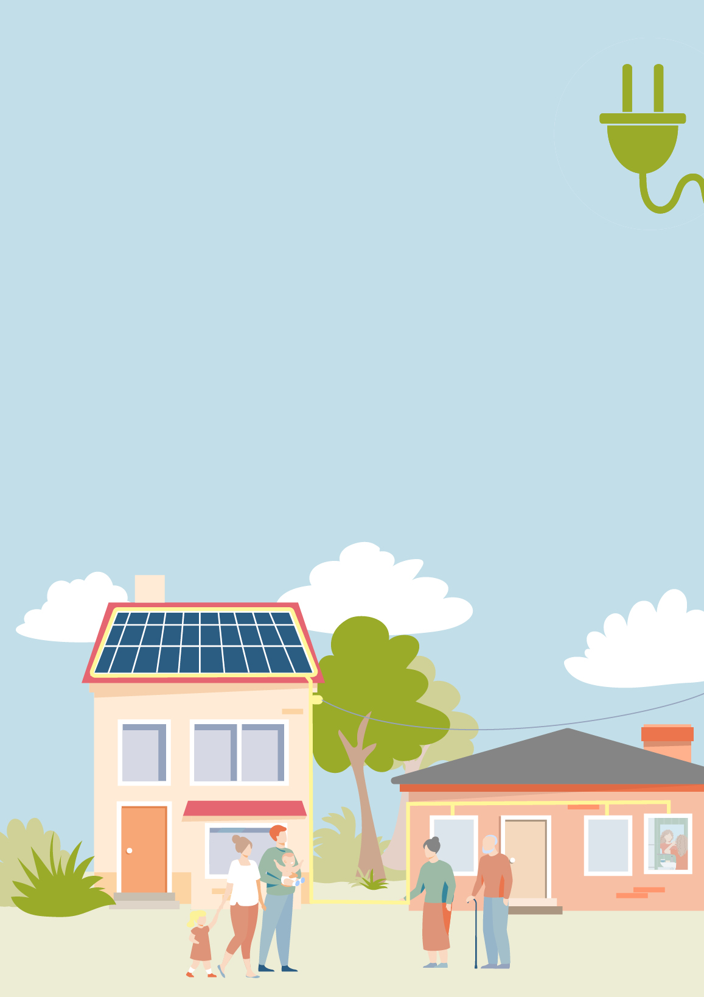
BE PART OF THE CHANGE
GET YOUR ENERGY
FROM YOUR NEIGHBORS!
→ How are we supposed to stop climate change?
→ How can we reduce our energy costs?
→ How can our neighbourhood get fit for the future?
We can make it possible:
climate friendly & locally produced energy
independence from fluctuating energy prices
adding value to our community and creating jobs
*add specific benefits your project offers to the community*
How? →

Slide 2
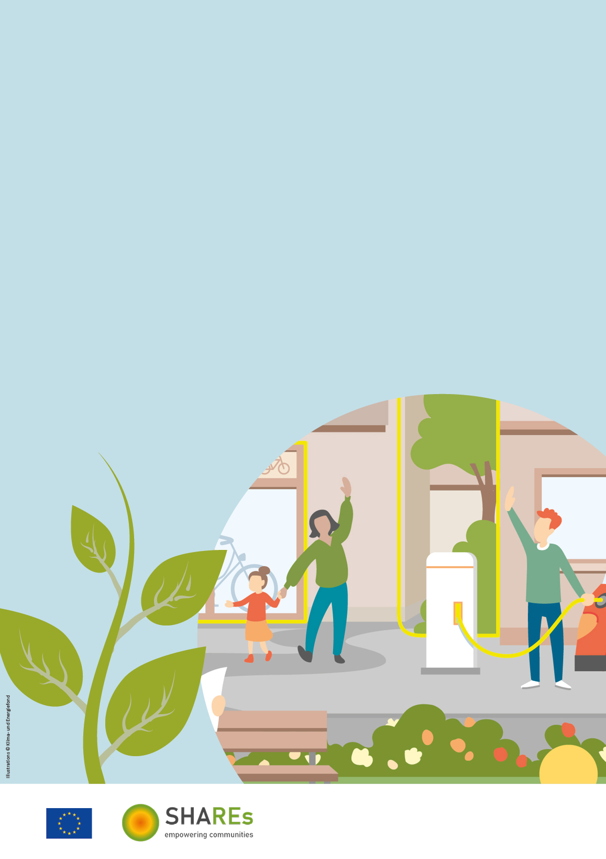
The ExampleEnergyCommunity
is the answer we have all been looking for:
In an energy community, energy is locally produced,
shared, and used in a neighbourhood.
Public bodies, companies, and residents join forces
to shape the energy future of our community together.
It‘s a win-win-situation for everyone – you, your neighbour,
and the climate!
Interested?
Find more information on
www.exampleenergycommunity.com
This flyer was made using material from a project that has received funding from the European Union's Horizon 2020 research and innovation programme under grant agreement No 101033722.
Illustrations by © Klima- und Energiefonds
This work © 2022 by Austrian Energy Agency is licensed under CC BY-NC-SA 4.0. To view a copy of this license, visit http://creativecommons.org/licenses/by-nc-sa/4.0/

