Slide 1
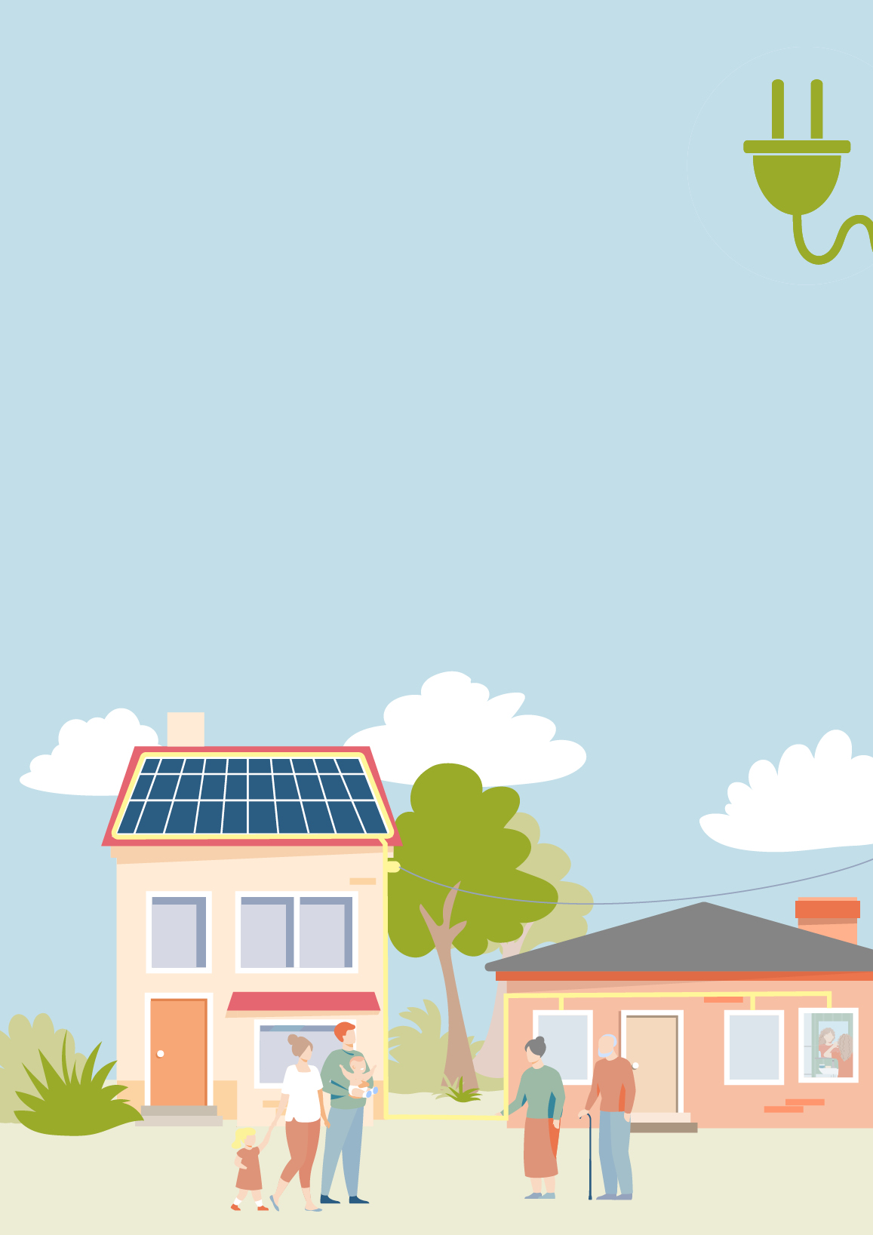
BE PART OF THE CHANGE
Information evening for our ENERGY REVOLUTION!
Saturday, the 22nd of April 2023
Town Hall Exampletown
With Mayor Grandheart & energy officer Mr. Esavings
Agenda
→ Benefits of setting up an energy community
→ Presentation on ExampleEnergyCommunity
→ Get to know each other and network

Slide 2
The ExampleEnergyCommunity
is the answer we have all been looking for:
In an energy community, energy is locally produced,
shared, and used in a neighborhood.
Public bodies, companies, and residents join forces
to shape the energy future of our community together.
It‘s a win-win-situation for everyone – you, your neighbor,
and the climate!
Interested?
Find more information on
www.exampleenergycommunity.com
This material is part of a project that has received funding from the European Union's Horizon 2020 research and innovation programme under grant agreement No 101033722.
Illustrations by © Klima- und Energiefonds
This work © 2022 by Austrian Energy Agency is licensed under CC BY-NC-SA 4.0. To view a copy of this license, visit http://creativecommons.org/licenses/by-nc-sa/4.0/

